Slide 1
Intermediate Python: Updating VS Code
Data Structures, Algorithms & Object-Oriented Programming

Slide 2
Updating VSCode
In this lecture we will update vscode (if there are any updates)
Open up the Anaconda Navigator and proceed to the next slide.
If you installed Anaconda Navigator in the previous lecture, from the command line (terminal or anaconda prompt) you will need to open anaconda navigator from the command line. You will always need to open in this way.

Slide 3
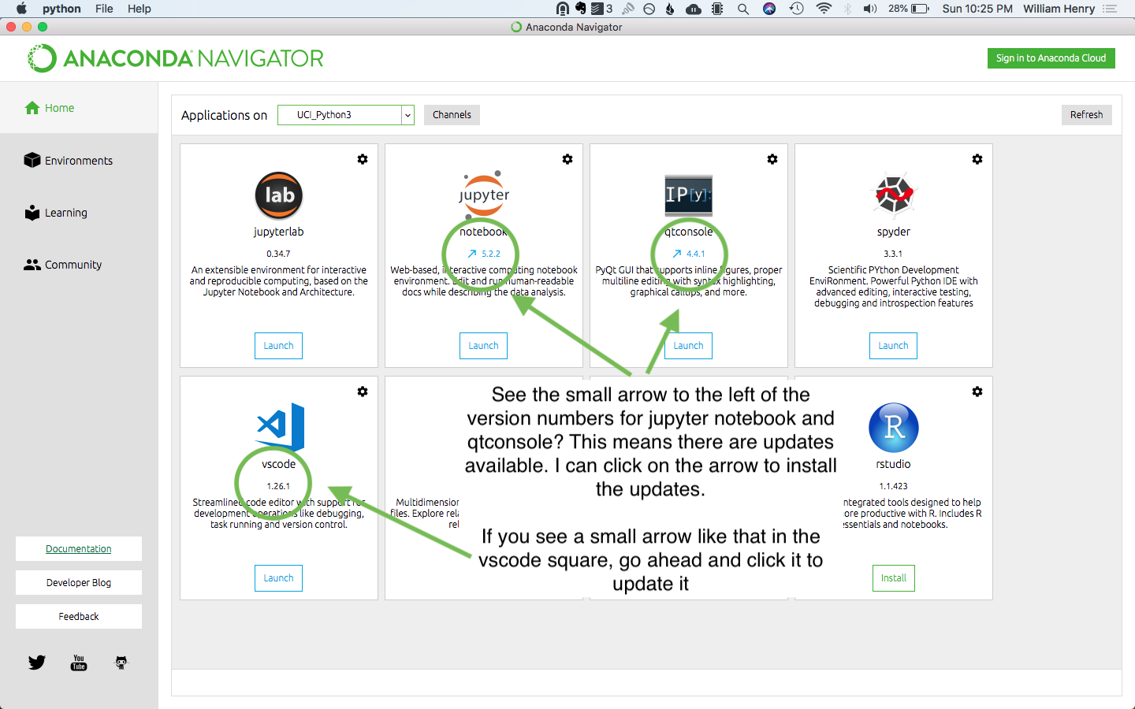
Updating VSCode

